Slide 1


Artificial Intelligence and Data Science
Data Science and Visualization
24ADI204
DATA-VIZ HACK-A-BIT (2026-2027)
PROJECT REVIEW (November 2026)
Team Number: 17
"The Heat Is On: A Visual Timeline of Global Warming"
“Warming stripes” visualization style

Slide 2

Problem Statement
Why this project matters:
Rising global temperatures are reshaping weather, sea levels and ecosystems, but the scale of this change is hard to grasp from raw numbers alone.
This project uses 124 years of country-level climate data (1900-2023) to examine, in a clear visual way, how temperature anomalies have changed over time and across countries.
1900–2023
Years of climate data
195
Countries covered
100,000
Records analyzed

Slide 3

Project Objectives
  We explore historical temperature anomaly data from 1900 to 2023 across 195 countries.
  We look for long-term trends and patterns across countries and decades.
  We clean the dataset thoroughly, handling missing values and outliers so the analysis stays reliable.
  We aim to build an interactive dashboard that tells the story of the data clearly.
  We document our process clearly each week so our GitHub repo tells the full story of the project.

Slide 4

Dataset Description
Here are the key details of our dataset:
  The dataset is a structured CSV file from Kaggle: Global Warming Dataset, 195 Countries (1900-2023).
  The variable we study most closely throughout the project is Temperature_Anomaly.
  The data is structured and almost entirely numeric, with Country as the only categorical field.
100,000
Records
195
Countries
26
Columns
1900–2023
Years covered

Slide 5

Project Workflow (Weeks 1 to 8)
What we did each week:
  Week 1: selected the Kaggle Global Warming dataset and set up the GitHub repository.
  Week 2: data quality report covering structure, data types, missing values and duplicates.
  Week 3: cleaning with median imputation, plus IQR and Z-score outlier checks.
  Week 4: exploratory data analysis with 30 visualizations.
  Week 6: feature engineering: skewness check, scaling and encoding.
  Week 7: correlation analysis and PCA.
  Week 8: interactive dashboard in Power BI.

Slide 6
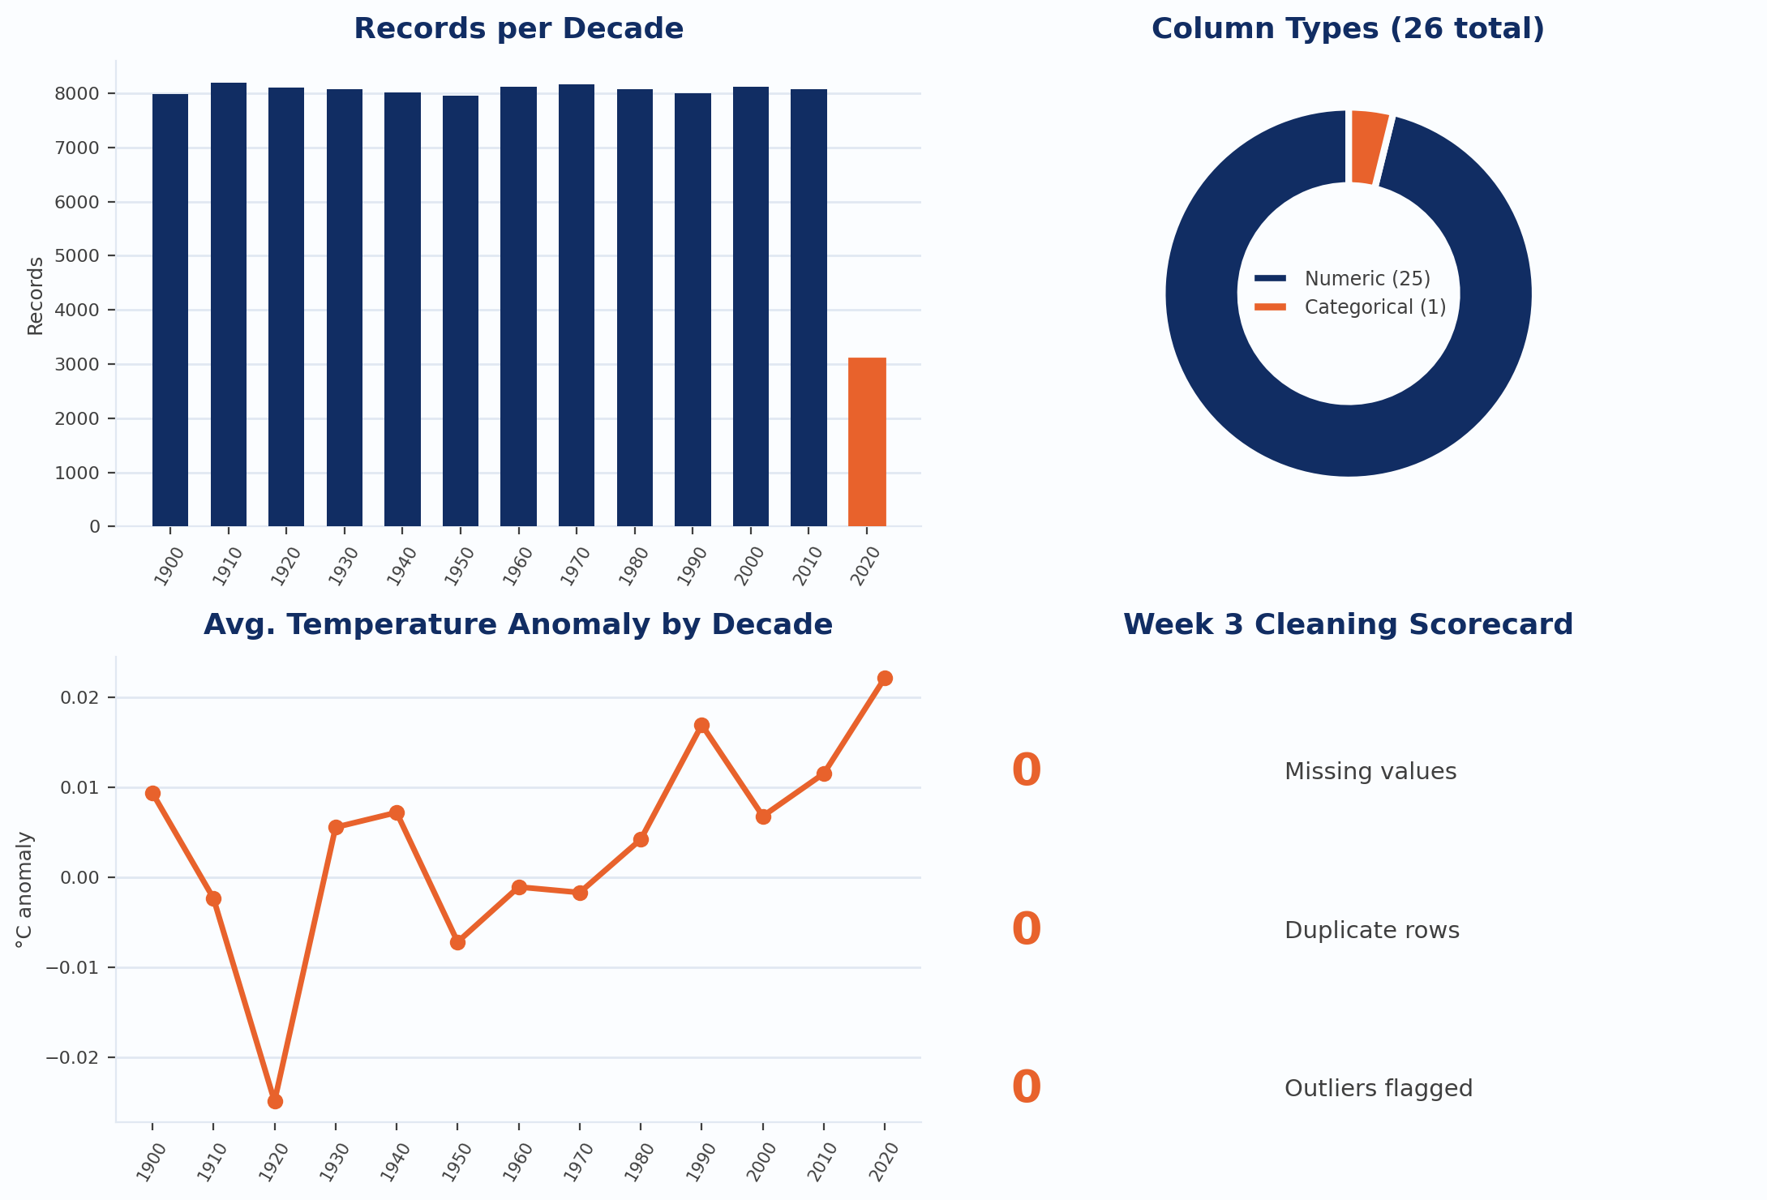
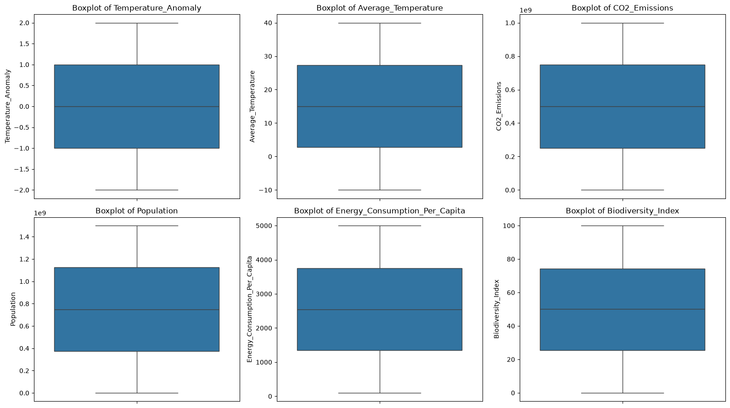
Weeks 2 and 3: Data Quality and Cleaning
12,000 missing cells were filled with the median, and we found 0 duplicates and 0 outliers.

Slide 7
Weeks 2 and 3: What We Did
How we checked and cleaned the data:
  The first check showed 100,000 rows, 26 columns, 12,000 missing cells and 0 duplicate rows.
  Missing values were filled with the column median: 12,000 missing cells before, 0 after.
  We chose the median because it is not affected by extreme values.
  Every numeric column was tested for outliers with IQR and Z-score (threshold 3): 0 found.
  Negative average temperatures were kept, because they are valid in degrees Celsius.
  No rows were removed: 100,000 records before and after cleaning.

Slide 8
Weeks 2 and 3: What We Did
How we checked and cleaned the data:
  The first check showed 100,000 rows, 26 columns, 12,000 missing cells and 0 duplicate rows.
  Missing values were filled with the column median: 12,000 missing cells before, 0 after.
  We chose the median because it is not affected by extreme values.
  Every numeric column was tested for outliers with IQR and Z-score (threshold 3): 0 found.
  Negative average temperatures were kept, because they are valid in degrees Celsius.
  No rows were removed: 100,000 records before and after cleaning.

Slide 9
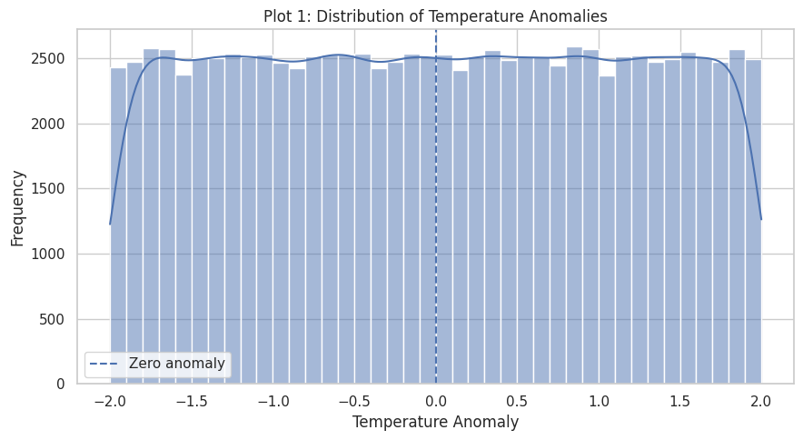
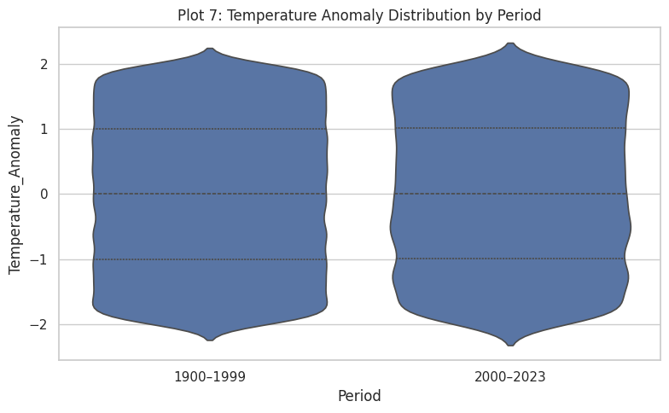
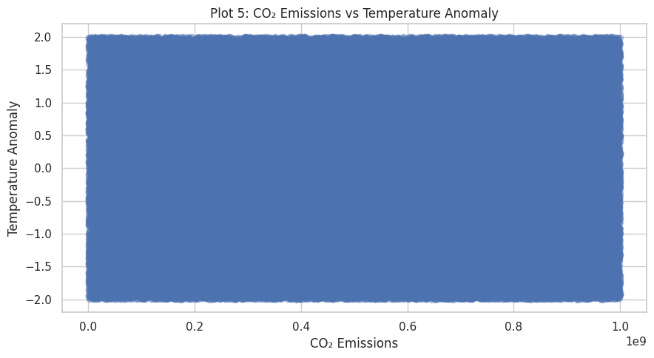
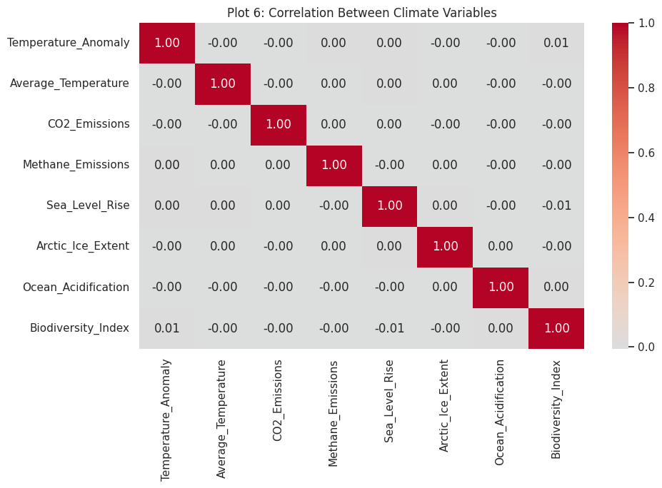
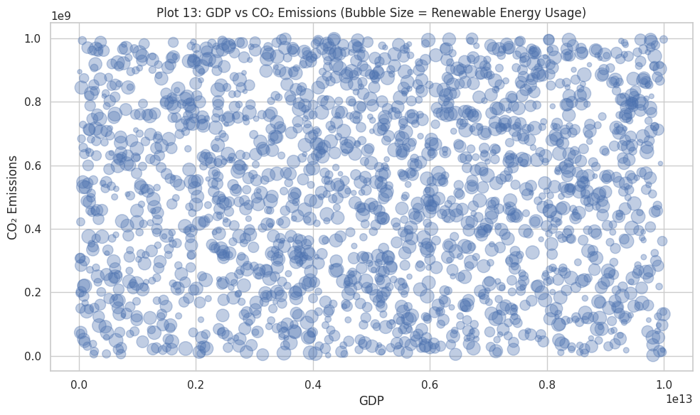
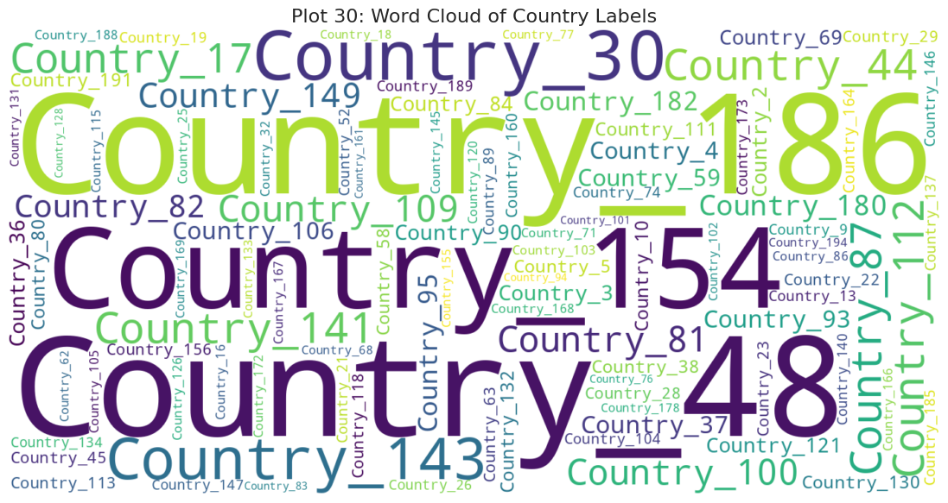
Week 4: Exploratory Data Analysis
We built 30 visualizations of different types. Here are six of them.

Slide 10
Week 4: What We Did
What we did:
  Loaded the cleaned dataset (100,000 rows, 26 columns, 0 missing values).
  Built 30 visualizations with Matplotlib and Seaborn, each of a different chart type.
  Univariate analysis: histogram, KDE, boxplot, violin and ECDF to see how single variables are distributed.
  Bivariate analysis: scatter, regression, hexbin and joint plots to see how two variables relate.
  Time analysis: line, step and area charts of yearly averages from 1900 to 2023.
  Multivariate analysis: correlation heatmaps, pair plot and parallel coordinates.
  Result: the correlations are close to zero, so the variables have no linear relationship.

Slide 11
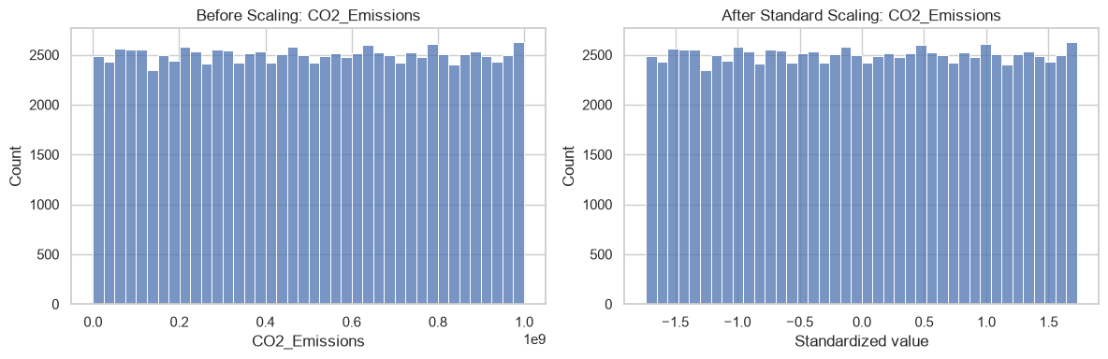
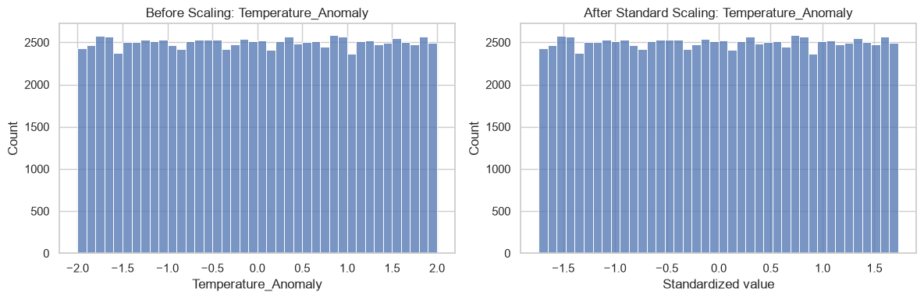
Week 6: Feature Engineering
Standard scaling changes the scale of a feature, not the shape of its distribution.

Slide 12
Week 6: What We Did
What we did and found:
  Skewness is about 0 in every column, so the data is symmetric and no skewness correction was needed.
  After StandardScaler, each numeric feature has mean 0 and standard deviation 1.
  After MinMaxScaler, each numeric feature runs from 0 to 1.
  After one-hot encoding, 26 columns became 220 (25 other columns plus 195 country columns).
  Year was left unscaled because it is a time label, not a measurement.

Slide 13
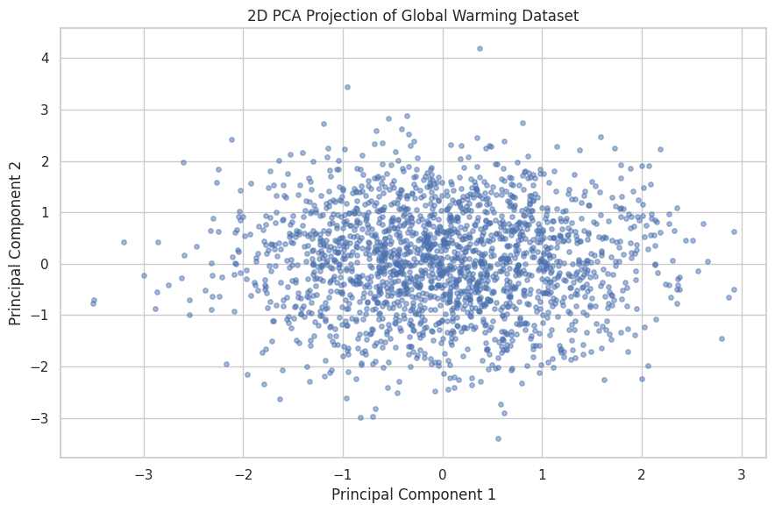
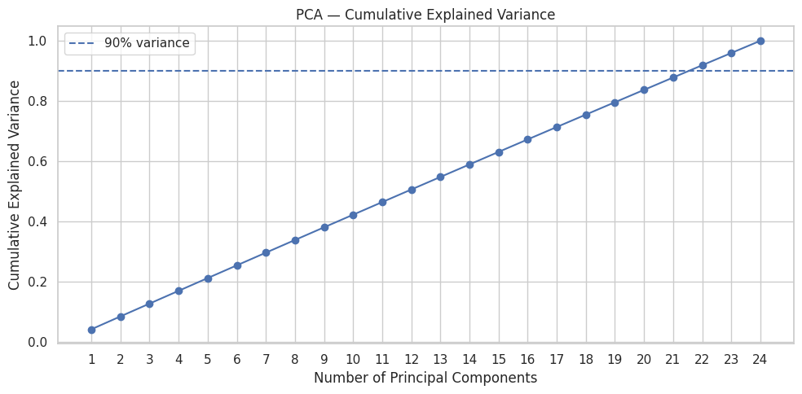
Week 7: Feature Selection and PCA
No feature pair reaches 0.90, and 22 of 24 components keep 91.88% of the variance.

Slide 14
Week 7: What We Did
Reading the results:
  No feature pair is highly correlated, so every feature carries its own information.
  Each principal component explains about 4% of the variance, roughly 1 part in 24.
  That is why the cumulative variance line is straight, and 22 components are needed to reach 90%.
  The 2D scatter is one round cloud: the records do not form separate groups.
  Conclusion: the features are weakly correlated, so this dataset cannot be reduced much further.

Slide 15
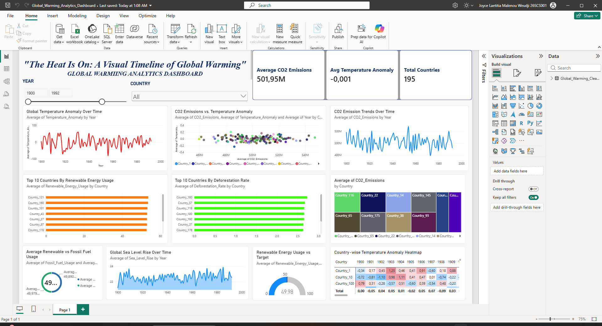
Week 8: Power BI Dashboard
Our Global Warming Analytics Dashboard has 10 charts, 3 KPIs and 2 slicers on one page.

Slide 16
Week 8: What We Did
What we built and what it shows:
  We used the Week 3 cleaned dataset, so all values stay in their original units.
  DAX measures give the KPI cards and the gauge (target of 50 on a scale of 0 to 100).
  Top: the title, the year and country slicers, and the KPI cards.
  First row: temperature anomaly over time, CO2 vs anomaly, and CO2 over time.
  Second row: top 10 countries for renewable energy, deforestation and CO2.
  Last row: renewable vs fossil fuel usage, sea level rise, the gauge and the heatmap.
  Example for 1900 to 1992: average CO2 501.95M, average anomaly −0.001, 195 countries.

Slide 17

Roles & Responsibilities
Team Member | Roles & Responsibilities
V Jayavanadhi | Data Analyst
Joyce Laetitia Malenou Weudji | Data Analyst & Storyteller
Gurupriya | Data Engineer
Manoj SS | Visualization Expert

Slide 18
References
Global Warming Dataset: 195 Countries (1900-2023), Kaggle, by ankushpanday1
Pandas Documentation: pandas.pydata.org
Matplotlib Documentation: matplotlib.org
Seaborn Documentation: seaborn.pydata.org
Microsoft Power BI Documentation: learn.microsoft.com/power-bi

